Slide 1
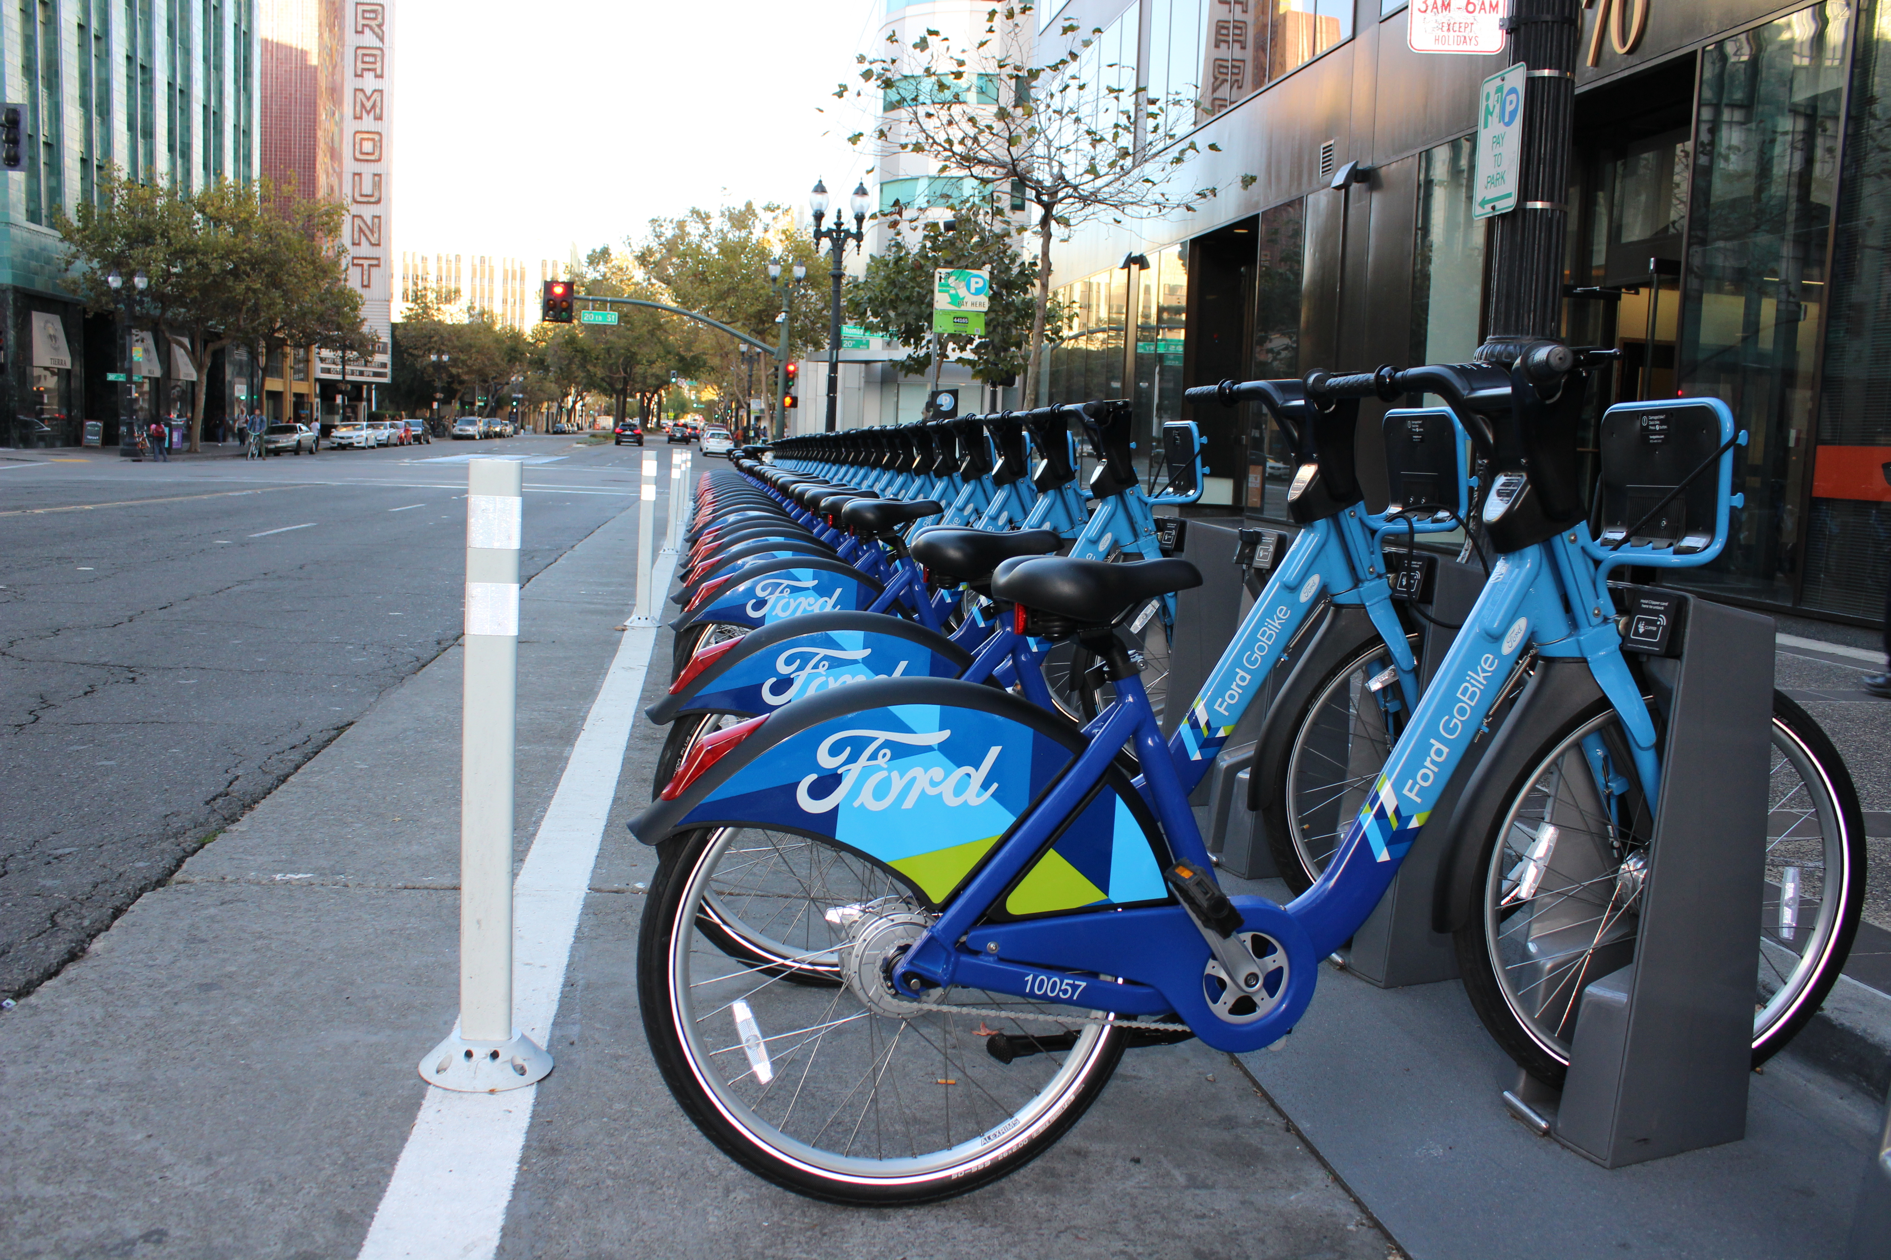
Bay area bike RECOMMENDATION APP
ANANT AGARWAL
ARPITA JENA
ASMITA VIKAS
DEENA LIZ JOHN

Slide 2
INTRODUCTION
RECOMMENDATION APP
DATA DESCRIPTION
IMPLEMENTATION IN SPARK
MODEL BUILDING
FUTURE SCOPE
LESSONS LEARNED

Slide 3
Introduction
Pick up a bike at any Ford GoBike station.
Ride across SF for quick trips!
End a trip by returning at any bike station.

Slide 4
Business Problem
Given the shortage of bikes, there is a need to optimize availability of bikes to users.
With the existing Ford GoBike App, real-time bike availability information can be tracked.
Need a tool to plan future rides.

Slide 5
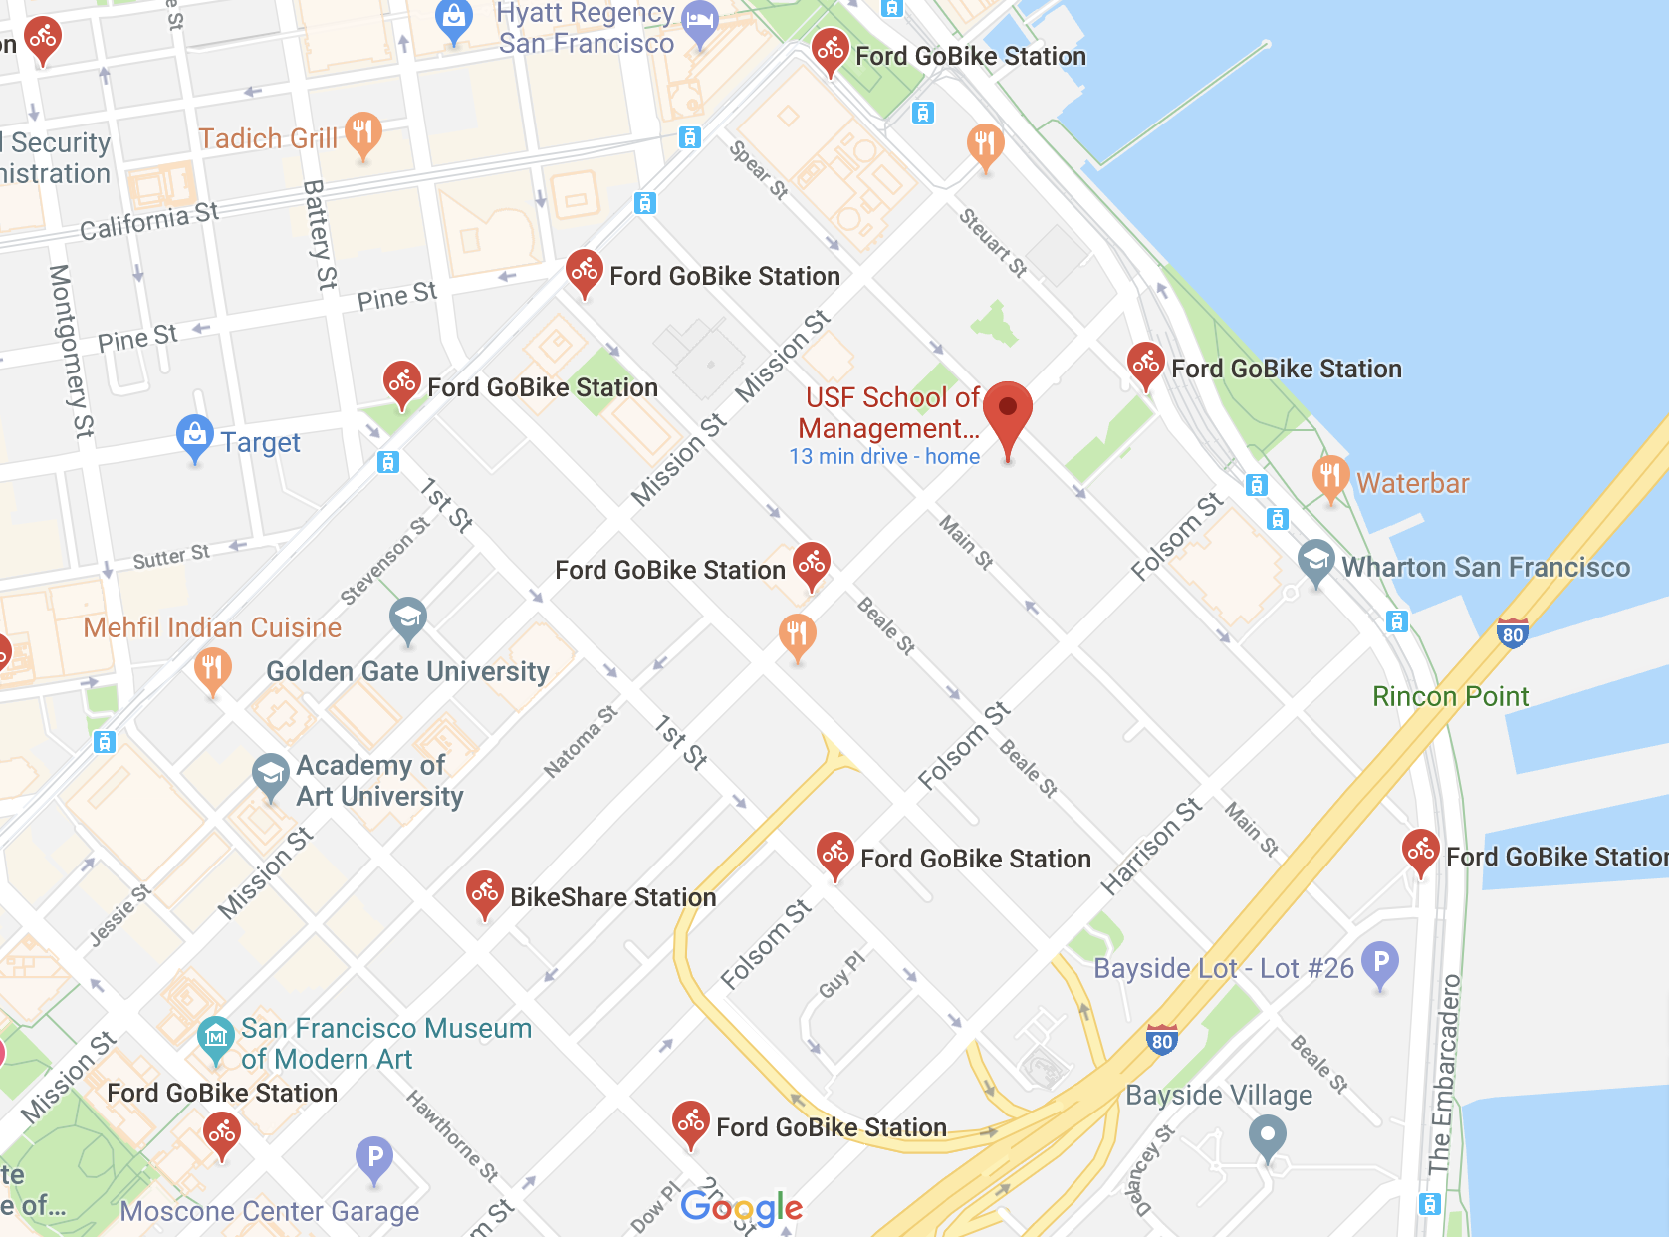
Recommendation System
System finds nearest station for future rides based on traffic and bike availability using Google Maps API.
Users are provided a ranked list of these stations based on predicted bike availability and traffic.

Slide 6
DEMO

Slide 7
Data Description
2.5 GB data from Ford GoBike data release with trip and station information.
Data from January 2013 to August 2016.
Nearly 71 million trips.
Over 15 features of weather information was used as external data.

Slide 8
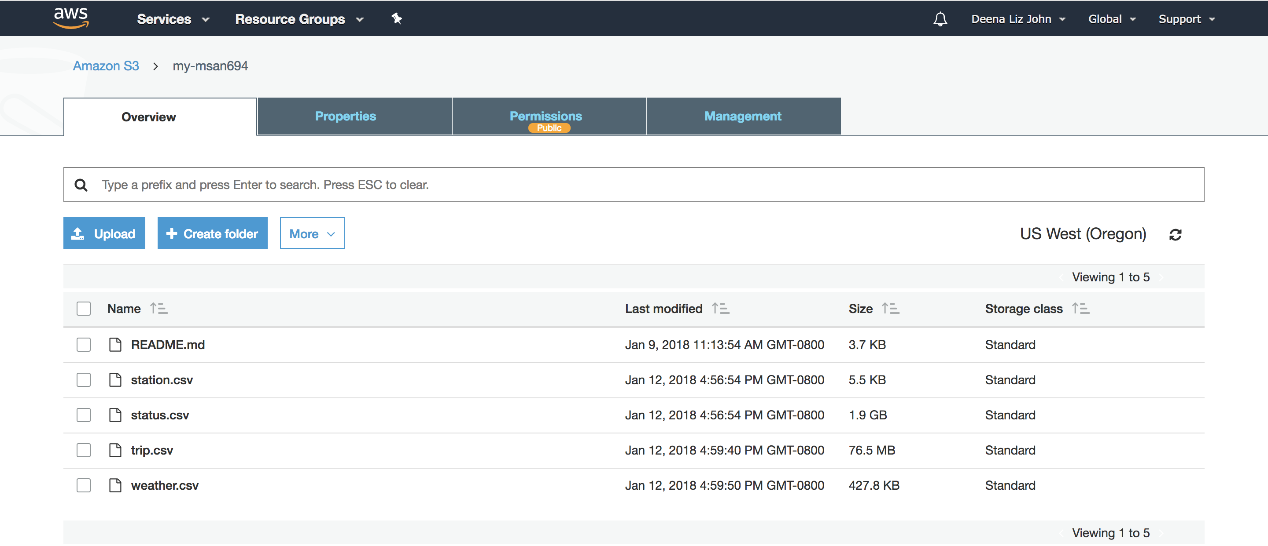

Implementation in Spark
Data loaded in S3
EC2 Instance

Slide 9
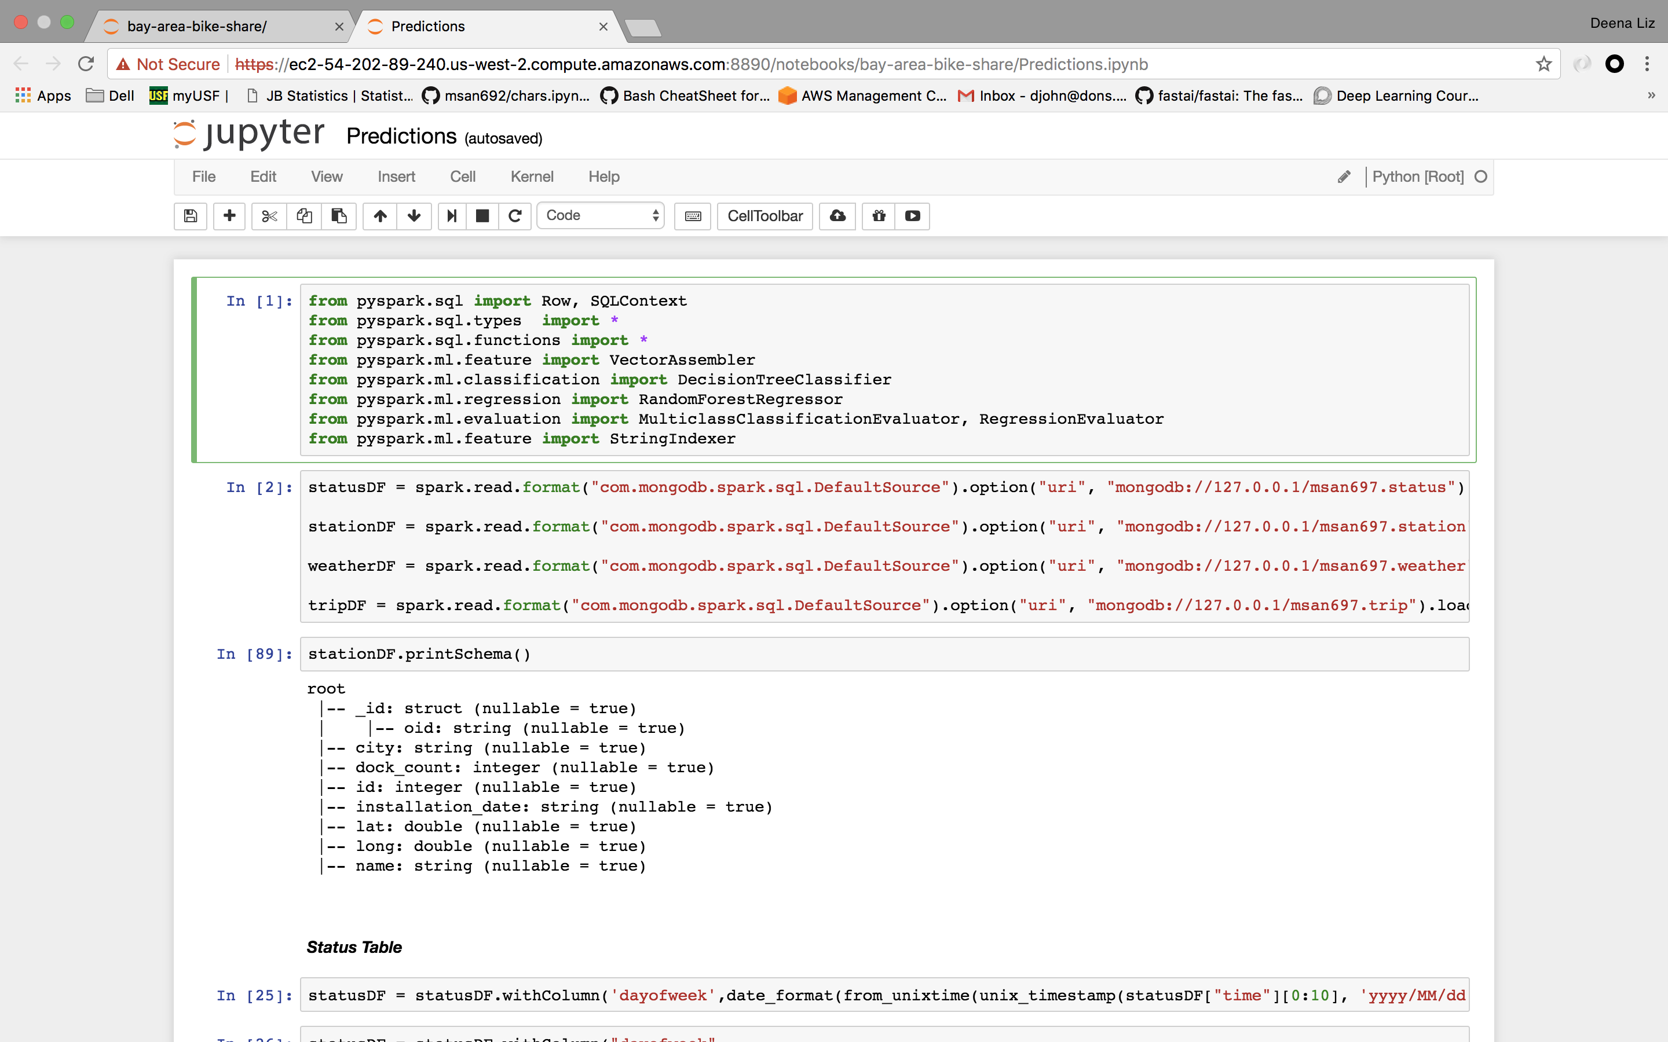
Querying on EC2

Slide 10
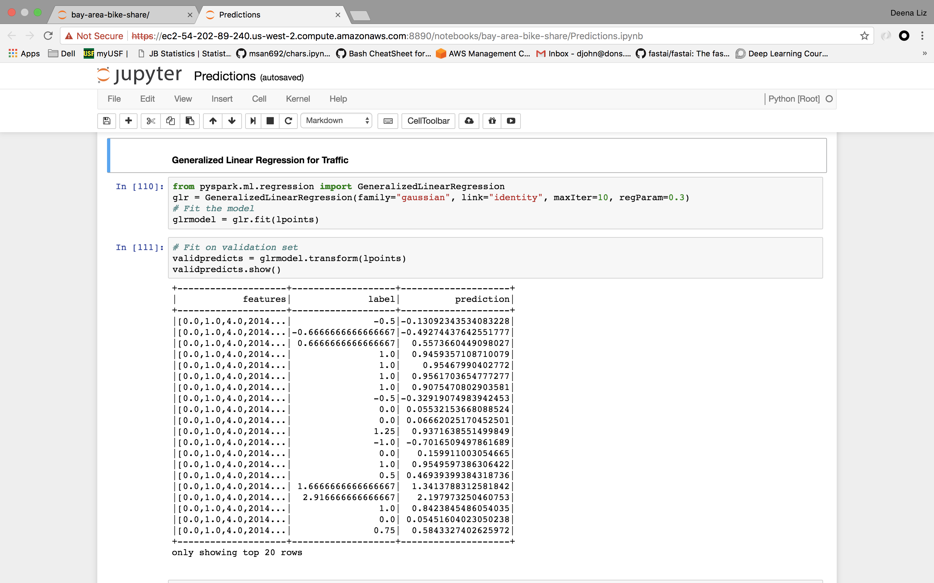
Implementing Generalized Linear Regression model to predict Traffic

Slide 11
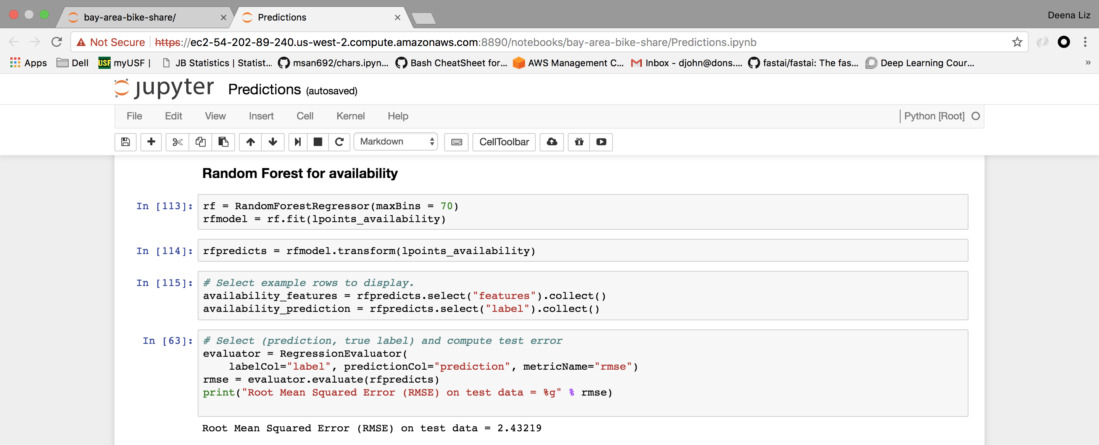
Implementing Random Forest model to predict Availability

Slide 12
Future Scope
Integrate real-time bike availability to update suggested future rides.
Track location of user to suggest new stations.
Recommend stations for bike drop-offs based on dock availability before even starting a trip.

Slide 13
Lessons Learned
Cluster capacity and CPU memory should be in proportion with the volume of data.
Caching the final tables after processing helped in quick modeling, avoiding reruns of the entire code.
Writing SQL queries for feature engineering was easier by registering dataframes in the table catalog.
Correct merge conflicts for Git repositories!

Slide 14
THANK YOU

